Slide 1
AI and Big Data Resources

Slide 2
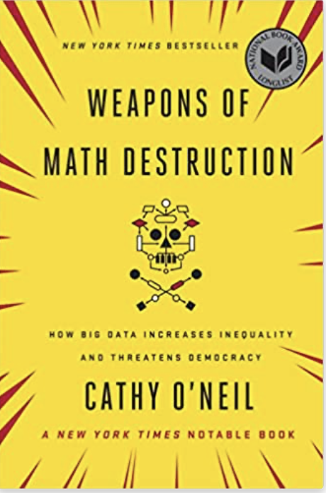
Weapons of Math Destruction: How Big Data Increases Inequality and Threatens Democracy
by Cathy O'Neil
Published 2016

Slide 3
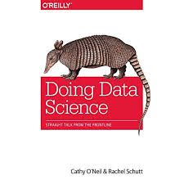
Doing Data Science: Straight Talk from the Frontline
by Cathy O'Neil
Published 2013

Slide 4
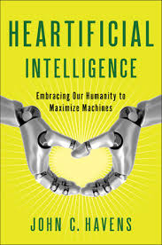
Heartificial Intelligence: Embracing Our Humanity to Maximize Machines
by John Havens
Published 2016

Slide 5
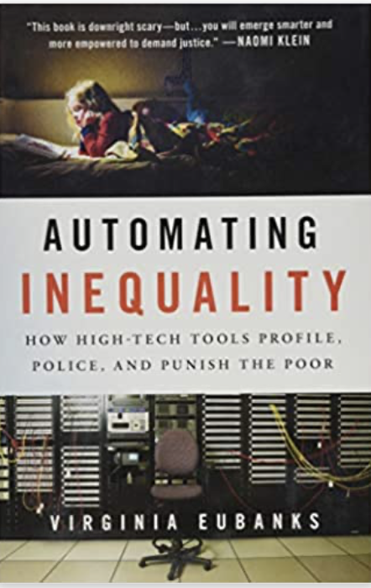
Automating Inequality: How High-Tech Tools Profile, Police, and Punish the Poor by Virginia Eubanks
Published 2018

Slide 6
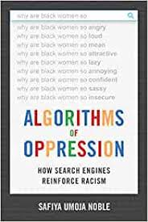
Algorithms of Oppression: How Search Engines Reinforce Racism
By Safiya Noble
Published 2018

Slide 7
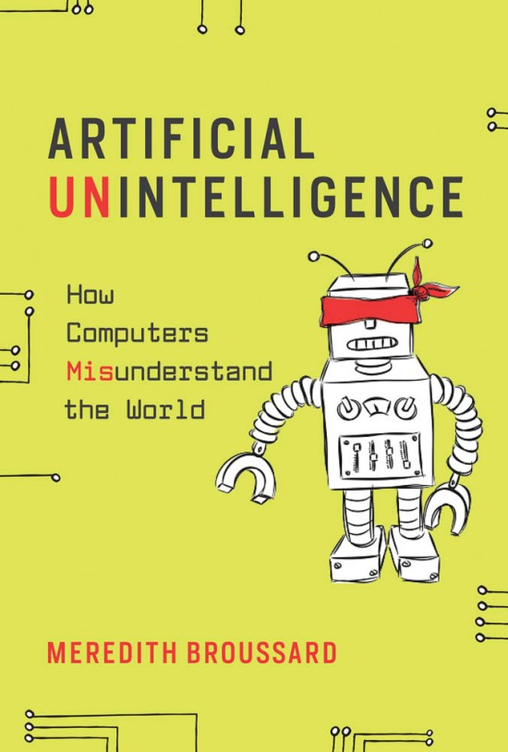
Artificial Unintelligence: How Computers Misunderstand the World
By Meredith Broussard
Published 2018

Slide 8
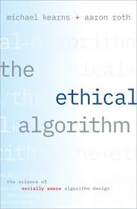
The Ethical Algorithm: The Science of Socially Aware Algorithm Design
By Aaron Roth and Michael Kearns
Published 2019

Slide 9
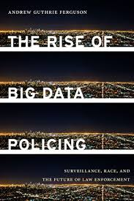
The Rise of Big Data Policing: Surveillance, Race, and the Future of Law Enforcement
By Andrew G. Ferguson
Published 2017

Slide 10
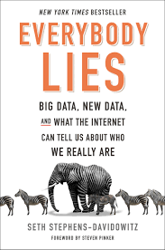
Everybody Lies: Big Data, New Data, and What the Internet Can Tell Us About Who We Really Are
By Seth Stephens-Davidowitz
Published 2017

